Slide 1
SG8002 Lesson 2: Word Stress & Definition and Classification
Semester A 2021-2022

Slide 2
Last lesson
This lesson
Course introduction
International Phonetic Alphabet (IPA)
Pronunciation of monophthongs, diphthongs (= vowels) and consonants
Recommended Websites, Dictionaries and Apps:
BBC – The Sounds of English:
http://www.bbc.co.uk/learningenglish/english/features/pronunciation
Cambridge Online Dictionary:
https://dictionary.cambridge.org/
Sounds Right app:
https://learnenglish.britishcouncil.org/en/apps/learnenglish-sounds-right
English Pronunciation app:
https://play.google.com/store/apps/developer?id=KEPHAM&hl=en
Explanation strategies
Questions?
Quick review of IPA
Word Stress
Teaching Strategy: Definition and Classification
Presentation Skills: smiling, stress, hand gestures and signposting
Mini-teaching Demonstration (1) using Definition and Classification
Introduction to OPTIMUS website
Homework explanation

Slide 3
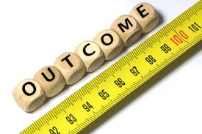
Intended Learning Outcomes
By the end of today’s class, you should be able to:
a. understand the importance of word stress
b. recognise different word stress patterns
c. explain why Definition and Classification are
important in teaching
d. identify and apply organizational structures for
Definition and Classification in teaching
e. understand the importance of different presentation
delivery techniques, including smiling, using word and
sentence stress, using hand gestures and signposting
f. identify and apply definition and classification language for a
brief teaching lesson with clear, correct, and appropriate
spoken English
g. know what the OPTIMUS website is and be able to use it as
a tool for speaking and presentation improvement

Slide 4


Slide 5
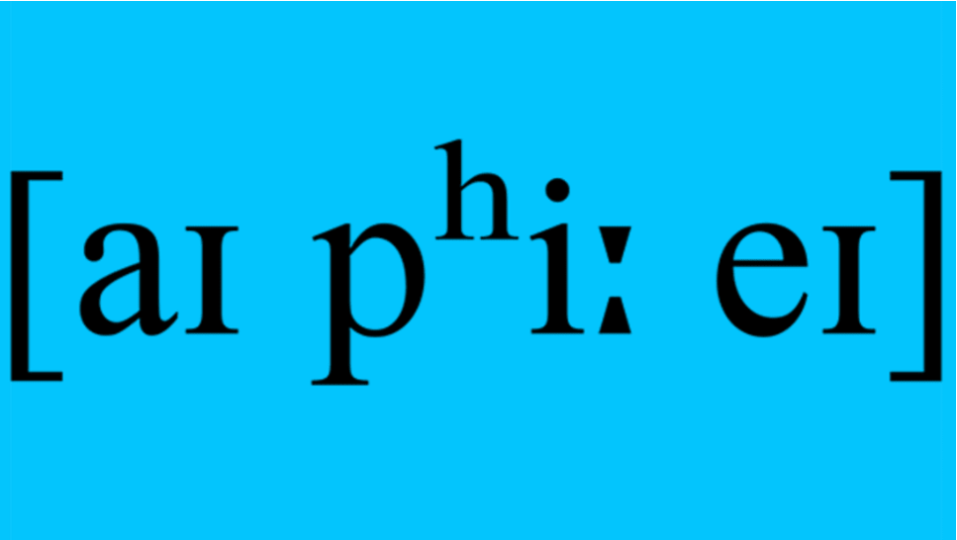
Revision of Last week’s Lesson:

Slide 6
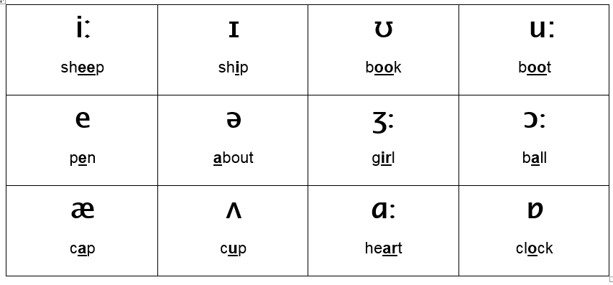
Individual Vowel Sounds (Monophthongs) listen and repeat after the teacher

Slide 7
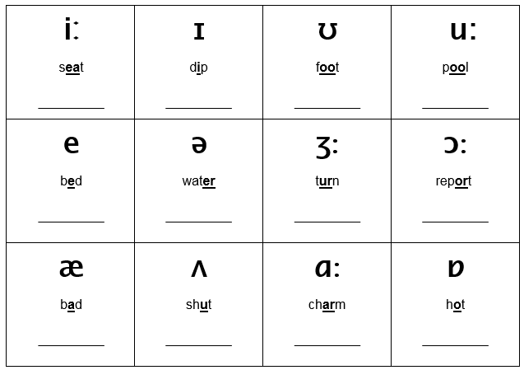
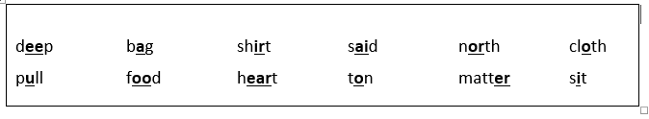
Individual Vowel Sounds (Monophthongs) Write the words below under the correct IPA symbol

Slide 8
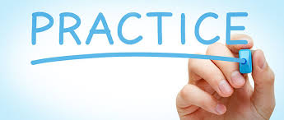
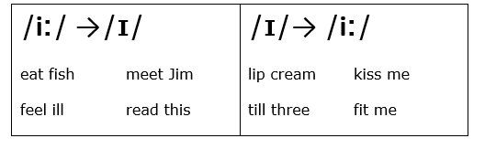

Individual Vowel Sounds (Monophthongs) Practise saying the sounds accurately
Record yourself on your phone and listen for accuracy.

Slide 9
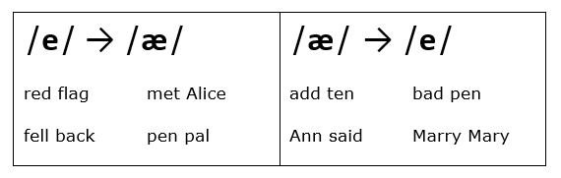
Individual Vowel Sounds (Monophthongs) Practise saying the sounds accurately
Record yourself on your phone and listen for accuracy.

Slide 10
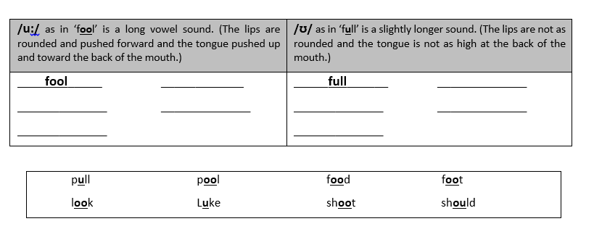
Individual Vowel Sounds (Monophthongs) Write the words below under the correct IPA symbol

Slide 11
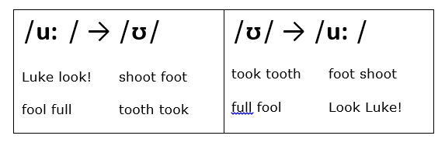
Individual Vowel Sounds (Monophthongs) Practise saying the sounds accurately
Record yourself on your phone and listen for accuracy.

Slide 12
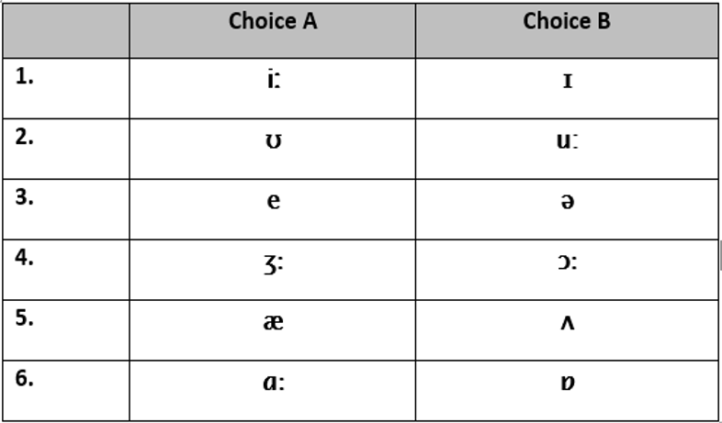
Individual Sounds: Vowels (Monophthongs) Circle the sound your teacher says

Slide 13
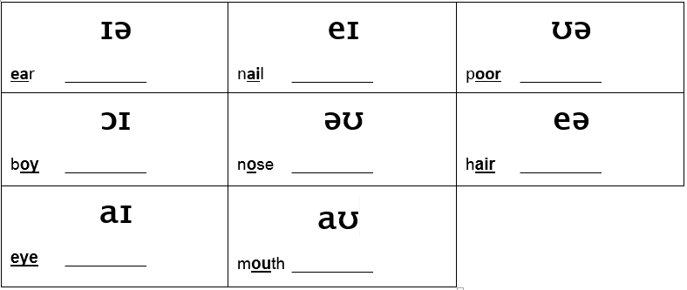
Diphthongs: Two combined vowel Sounds Practise saying the sounds accurately

Slide 14

Two combined vowel Sounds: Diphthongs Write the words below under the correct IPA symbol

Slide 15
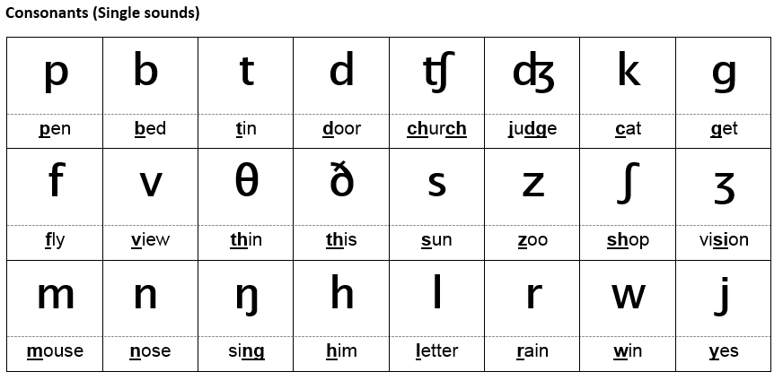
Individual sounds: Consonants Practise saying the sounds accurately

Slide 16
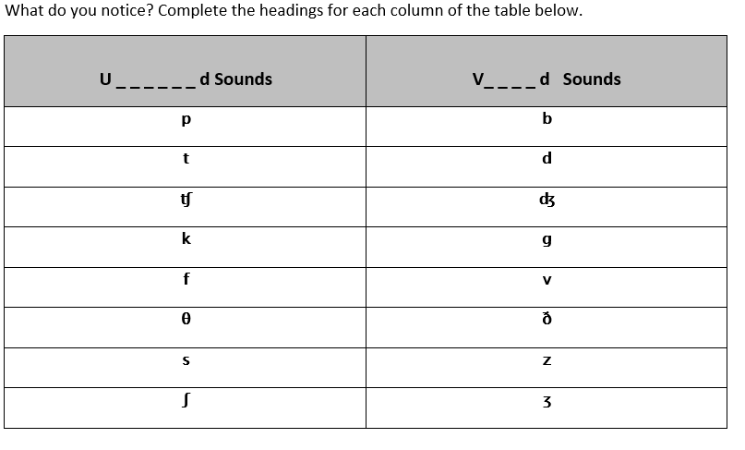
Individual sounds: Consonants

Slide 17

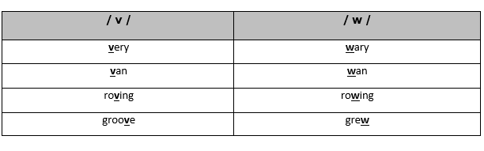
Individual sounds: Consonants
Practise:
1. Groves of vine veered west along the villain’s veranda.
2. Woollen vests for wailing wolves are worn in the vast woodlands.
Record yourself on your phone and listen for accuracy.

Slide 18
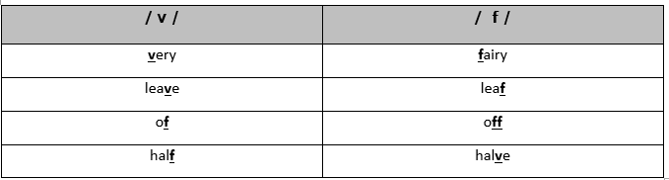
Individual sounds: Consonants
Practise:
1. Vivacious Vivian vacuumed Vincent’s very vivid vase.
2. Victoria vowed vengeance vociferously and vehemently.
Record yourself on your phone and listen for accuracy.

Slide 19
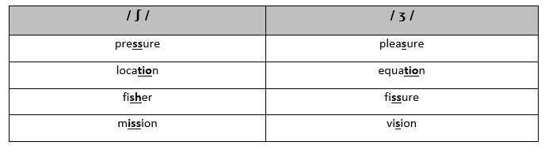
Individual sounds: Consonants
Practise:
1. Casual clothes are provisional for leisurely trips across Asia.
2. His treasure was measured in non-visual pleasure.
Record yourself on your phone and listen for accuracy.

Slide 20
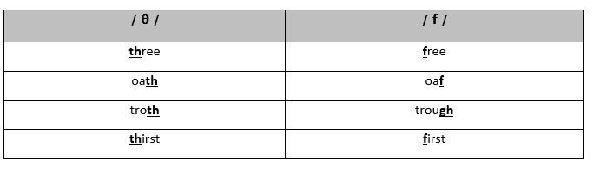
Individual sounds: Consonants
Practise:
1. Tom threw thirty three thousand thorny thistles.
2. Through three cheese trees three free fleas flew.
Record yourself on your phone and listen for accuracy.

Slide 21
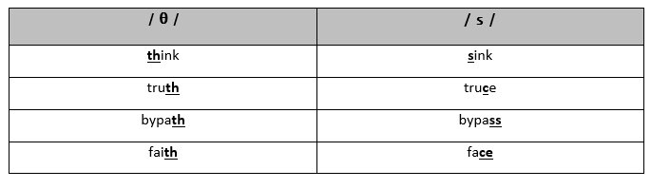
Individual sounds: Consonants
Practise:
1. Thelma sells thick thistles near the theatre.
2. Cassie threw Cathy some thick math books.
Record yourself on your phone and listen for accuracy.

Slide 22
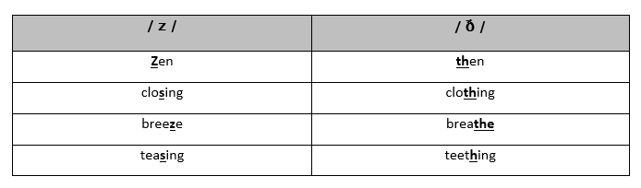
Individual sounds: Consonants
Practise:
1. Zero leather, weathered leather. Zero leather, weathered leather.
2. Mr. Dithers goes hither and thither to lather his withering plants.
Record yourself on your phone and listen for accuracy.

Slide 23
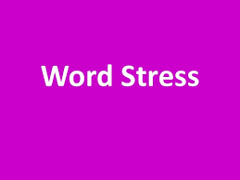
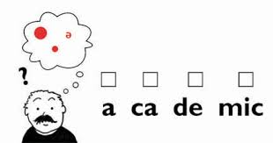
Lesson 2:

Slide 24
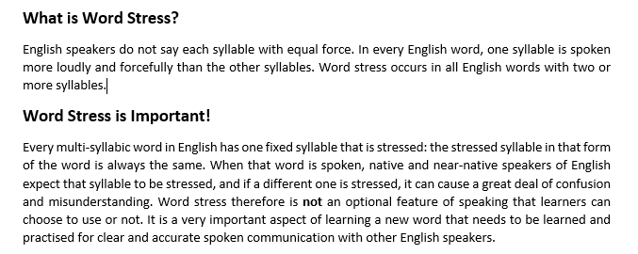

Slide 25
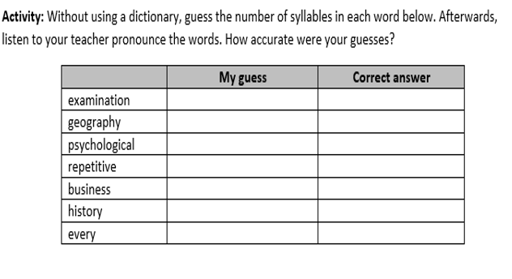









Slide 26
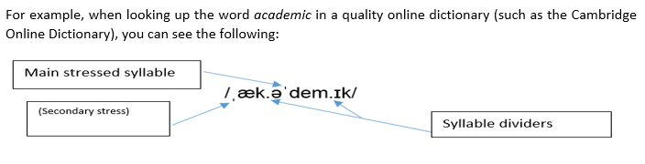
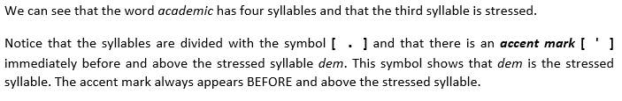


Slide 27
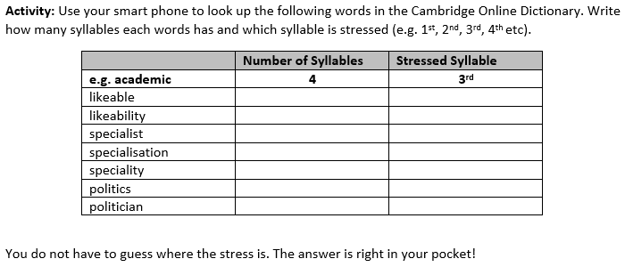

















Slide 28
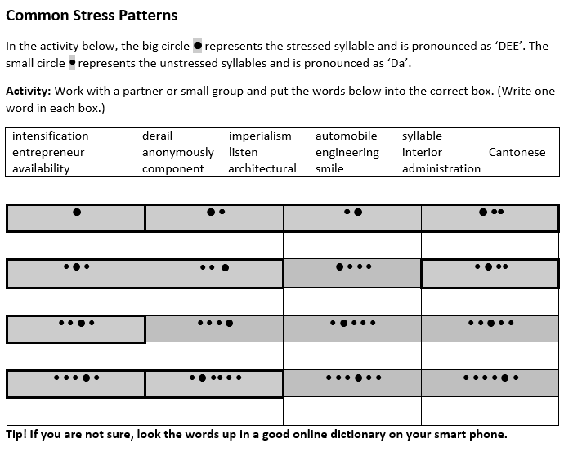









Slide 29
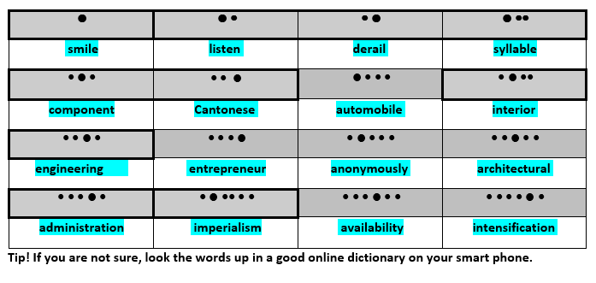
Answer Key:

Slide 30
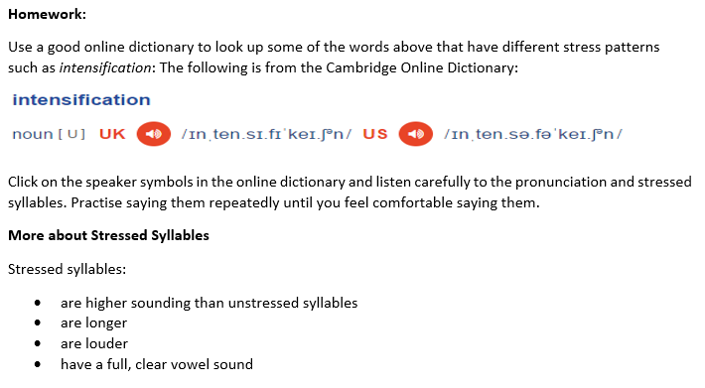

Slide 31
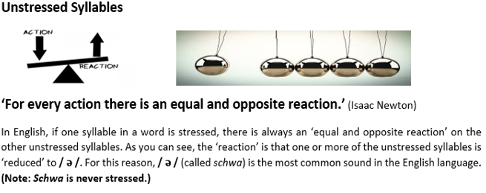
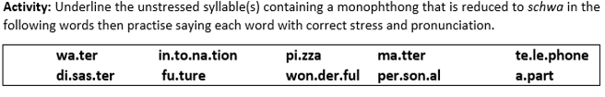
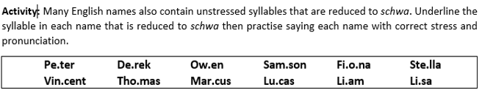
Let’s Practise!

Slide 32
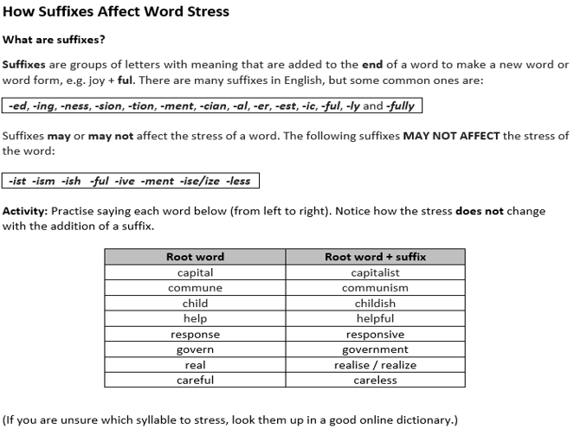

Slide 33

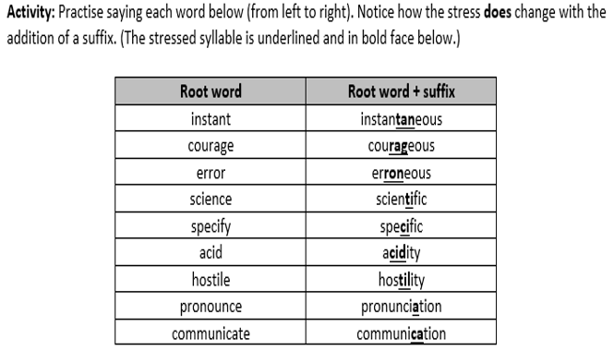

Slide 34

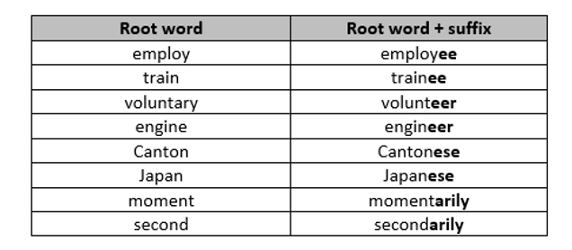
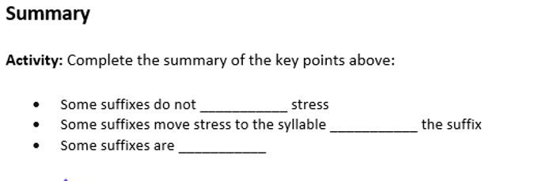
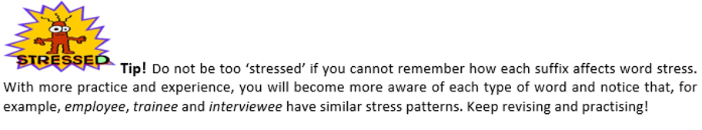
Activity: Practise saying each word below (from left to right). Notice how the suffix is stressed.

Slide 35
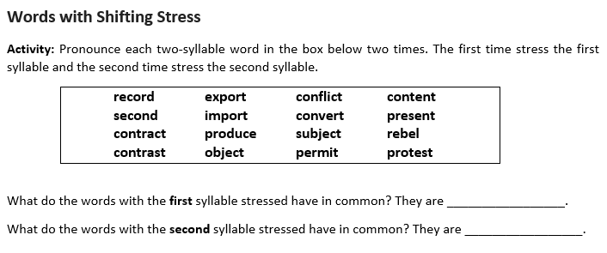

Slide 36
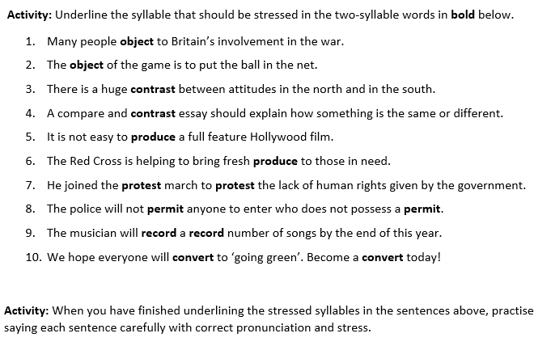

Slide 37
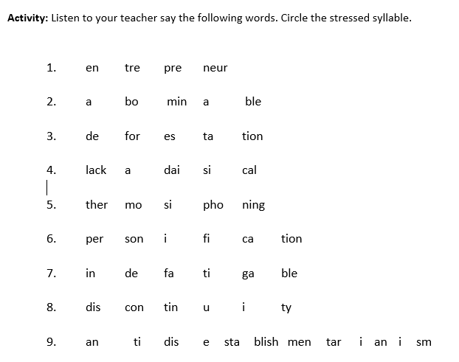

Slide 38
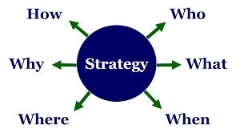
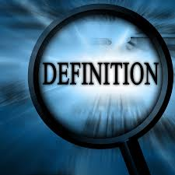

Teaching Strategy 2:
Definition and Classification

Slide 39

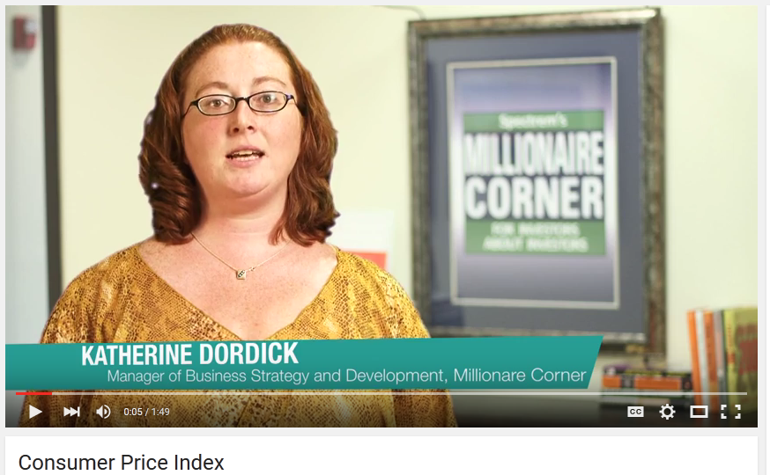
Listening
Listen to the video once and answer the questions as best as possible on the answer sheet.
https://www.youtube.com/watch?v=5nQPm_diIzQ

Slide 40
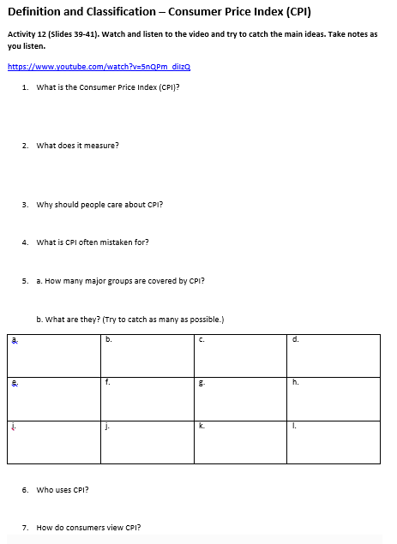

Slide 41
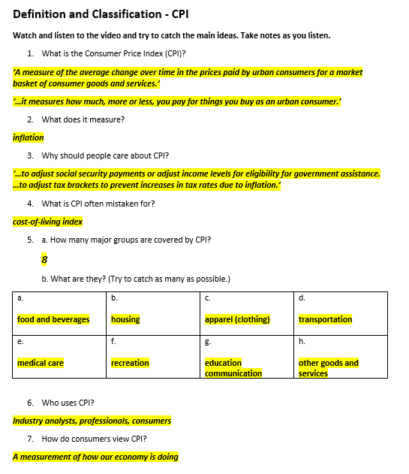

Slide 42


Signposting
One strategy good presenters use to make their talks easy to follow is signposting. In presentations, lecturing and teaching, signposts have the same function as they do on the street – they provide direction. In a presentation, signpost words and phrases tell the audience the direction the presentation will take and the sequence of the content that will be discussed. In short, signposting guides the audience through the presentation. As you can see below, signpost phrases have different functions.
‘Today I’d like to talk to you about…’
‘The second point I’d like to discuss today is…’
‘Now, let’s summarise the main points of what we discussed today. First,…’
‘This talk will be divided into three sections, first…’

Slide 43
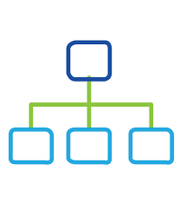
Listen Again for Structure
What is the overall structure of the speaker’s presentation? What are the different parts?
Listen to the video again and pay attention to the structure of the talk.
https://www.youtube.com/watch?v=5nQPm_diIzQ

Slide 44
Video 1 - Definition and Classification: Consumer Price Index (CPI)
https://www.youtube.com/watch?v=5nQPm_diIzQ
CPI is defined by the Bureau of Labor Statistics as a measure of the average change over time in the prices paid by urban consumers for a market basket of consumer goods and services. Now, what does that mean? That means, that it measures how much, more or less, you pay for things you buy as an urban consumer. Now why should you care? CPI is usually used as an inflation measurement. This figure is often used to adjust social security payments or adjust income levels for eligibility for government assistance. CPI is also used to adjust our nation’s tax brackets to hopefully prevent increases in tax rates due to inflation. CPI is not a cost-of-living index, however, as it is often mistaken for. The cost of living index would need to go far beyond the scope of the information provided in the CPI data. There are eight major groups that CPI covers: food and beverages; housing; apparel; transportation; medical care; recreation; education and communication; and other goods and services, such as tobacco products, haircuts, etc. CPI is used by many industry analysts and professionals in a wide variety of ways. But for many consumers, it is viewed as a measurement of how our economy is doing. As well as seeing or not seeing a change in their social security income, military income, civil service, retirement income, or many other income adjustments. For more video educational material, news, information, or resources, please visit our website at www.millionairecorner.com . Thanks for watching.
____________
____________
____________
____________
____________
_____________

Slide 45
Video 1 - Definition and Classification: Consumer Price Index (CPI)
https://www.youtube.com/watch?v=5nQPm_diIzQ
CPI is defined by the Bureau of Labor Statistics as a measure of the average change over time in the prices paid by urban consumers for a market basket of consumer goods and services. Now, what does that mean? That means, that it measures how much, more or less, you pay for things you buy as an urban consumer. Now why should you care? CPI is usually used as an inflation measurement. This figure is often used to adjust social security payments or adjust income levels for eligibility for government assistance. CPI is also used to adjust our nation’s tax brackets to hopefully prevent increases in tax rates due to inflation. CPI is not a cost-of-living index, however, as it is often mistaken for. The cost of living index would need to go far beyond the scope of the information provided in the CPI data. There are eight major groups that CPI covers: food and beverages; housing; apparel; transportation; medical care; recreation; education and communication; and other goods and services, such as tobacco products, haircuts, etc. CPI is used by many industry analysts and professionals in a wide variety of ways. But for many consumers, it is viewed as a measurement of how our economy is doing. As well as seeing or not seeing a change in their social security income, military income, civil service, retirement income, or many other income adjustments.
For more video educational material, news, information, or resources, please visit our website at www.millionairecorner.com. Thanks for watching.
Definition
Signposting
Uses
Limitations
Classification / categories
Signposting

Slide 46
Definition
Uses
Limitations
Classifications
Examples

Slide 47
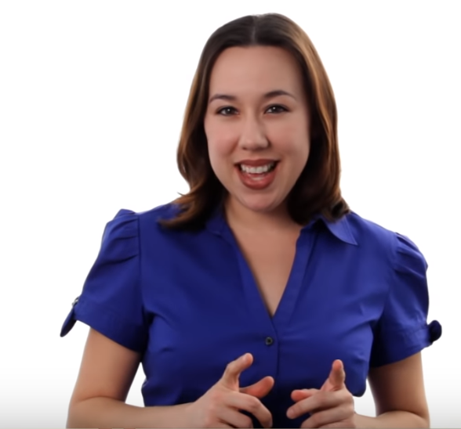
Video 2: Definition and classification
Watch this Definition and Classification video…
https://www.youtube.com/watch?v=EPfzJ9qaPcw
…and think about the structure and language of the talk.

Slide 48

How is this talk structured?

Slide 49
Hi. My name is Mary Poffenroth. I’m an adjunct professor of Biology and today we are going to talk about biodiversity. First let’s start by breaking up the word. Now, the first part, bio. That means life. The second part, diversity, that means differences. So think about the diversity in humans, how we’ll all very different. Now if you put those two words together you’re talking about the differences of life. Now high biodiversity, or having lots of biodiversity, is always a good thing. Let’s talk about the three different types of biodiversity. We’re going to go from smallest to largest. First, genetic diversity. Genetic diversity is important within a species or a population because that’s going to give that species the greatest chance of survival. When you have high genetic diversity, you’re just going to have more genes in that gene pool available to deal with environmental changes. Now let’s move to the middle one, species diversity. Now species diversity is going to be the different types of species you have in an ecosystem. However, you’re talking about, let’s say, a tropical rain forest, you're going to have huge, high species diversity. That means that ecosystem is doing well. But, even if you talk about a desert that diversity is going to be a little bit lower but you still want high species diversity that’s relative to that desert. And lastly, our largest type of biodiversity is ecosystem diversity. On the planet you want lots of different types of ecosystems. You don’t want just one ecosystem, let’s say, all grasslands. That would only support grassland species. So by having lots of different types of ecosystems you can support lots of different types of organisms. On our planet we have so many different types of ecosystems. Tropical rainforests. We have deciduous forests. We have tundra. And all of those different types of ecosystems help to make sure that our planet stays nice and healthy. Thanks for watching. And if you want to learn more about this subject, click on the link below. Or if you want to learn more biology, feel free to click on any of the links around me. And please, raise comments and subscribe to this channel. Or maybe, if you have ideas for more videos, send us an email, a request at mahalo.com. Thanks for learning.
____________
____________
____________
____________
____________
____________
____________

Slide 50
Hi. My name is Mary Poffenroth. I’m an adjunct professor of Biology and today we are going to talk about biodiversity. First let’s start by breaking up the word. Now, the first part, bio. That means life. The second part, diversity, that means differences. So think about the diversity in humans, how we’ll all very different. Now if you put those two words together you’re talking about the differences of life. Now high biodiversity, or having lots of biodiversity, is always a good thing. Let’s talk about the three different types of biodiversity. We’re going to go from smallest to largest. First, genetic diversity. Genetic diversity is important within a species or a population because that’s going to give that species the greatest chance of survival. When you have high genetic diversity, you’re just going to have more genes in that gene pool available to deal with environmental changes. Now let’s move to the middle one, species diversity. Now species diversity is going to be the different types of species you have in an ecosystem. However, you’re talking about, let’s say, a tropical rain forest, you're going to have huge, high species diversity. That means that ecosystem is doing well. But, even if you talk about a desert that diversity is going to be a little bit lower but you still want high species diversity that’s relative to that desert. And lastly, our largest type of biodiversity is ecosystem diversity. On the planet you want lots of different types of ecosystems. You don’t want just one ecosystem, let’s say, all grasslands. That would only support grassland species. So by having lots of different types of ecosystems you can support lots of different types of organisms. On our planet we have so many different types of ecosystems. Tropical rainforests. We have deciduous forests. We have tundra. And all of those different types of ecosystems help to make sure that our planet stays nice and healthy. Thanks for watching. And if you want to learn more about this subject, click on the link below. Or if you want to learn more biology, feel free to click on any of the links around me. And please, raise comments and subscribe to this channel. Or maybe, if you have ideas for more videos, send us an email, a request at mahalo.com. Thanks for learning.
Self-introduction
Signposting
Definition
Signposting
Type (classification) 1
Signposting
Type (classification) 2
Signposting
Type (classification) 3
Signposting
Conclusion

Slide 51
Definition and classification
defining and classifying physical and abstract concepts in English…
you can:
1) discuss general items
2) then discuss specific items
you can:
1) discuss major traits of something
2) then discuss minor traits of something
you can:
1) discuss something generally
2) then discuss major traits
3) then discuss minor traits
4) then give examples

Slide 52


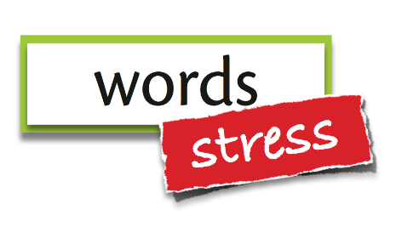
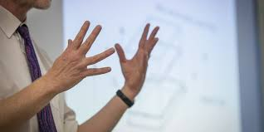
Four Effective Presentation and Teaching Delivery Techniques
Smile!
Use
Signposting!
Use word and sentence stress!
Use natural hand gestures!

Slide 53
Video 2: Definition and classification
Now watch video 2 again…
https://www.youtube.com/watch?v=EPfzJ9qaPcw
…and notice how well Mary delivers her talk by:
-smiling ☺ ☺
-using word and sentence stress (stressing key words in each sentence)
-using NATURAL hand gestures
-using signposting

Slide 54
Plan and deliver a 2-minute Definition and classification Mini-lesson
Think of a topic or concept which you are likely to teach to undergraduate Year One students in a course offered by your department here at CityU. Plan a 2-minute mini-lesson.
Step 1: plan the lesson (~10 min)
Choose a concept from your department
Think about how to define and classify that concept
Use appropriate language for definition and classification from today’s lesson
Select other vocabulary needed to explain the concept
Structure your explanation appropriately using definition and classification
Make brief notes of what you will say (don’t write full sentences!)
Step 2: When you teach your ~2 min lesson, remember to:
Smile ☺
Use accurate pronunciation
Use accurate word and sentence stress (stress of key words in the sentence)
Use NATURAL hand gestures
Use signposting
Change roles with your partner.

Slide 55
homework
Do at least one hour of OPTIMUS work; refer to and complete the OPTIMUS homework reflection form on pp 34-36 in Course Booklet, Lesson 2. Submit this in Lesson 3. (Compulsory)
Refer to the recommended on-line sites and apps from Lesson 1 for pronunciation and stress and do more practice.
Record or video yourself a few times teaching a simple concept with definition and classification from your discipline with the strategies you have learned today and last week. Critically analyze your recordings/videos and look for ways to improve them.

